Slide 1
Welcome to New York
Lesson 7-8 “Streets and avenues”
For the 9th form
Гудкова Ирина Алексеевна, учитель английского языка МБОУ «АСОШ №2» п.Адамовка.

Slide 2
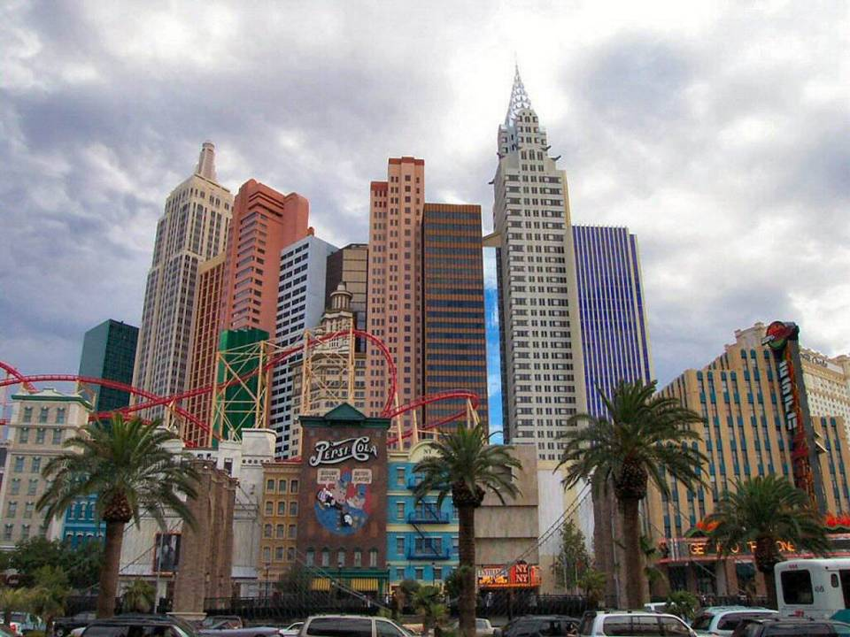
NEW YORK
“The City That Never Sleeps”, “The Capital of the World”, “The Center of the Universe”, “The Big Apple”

Slide 3
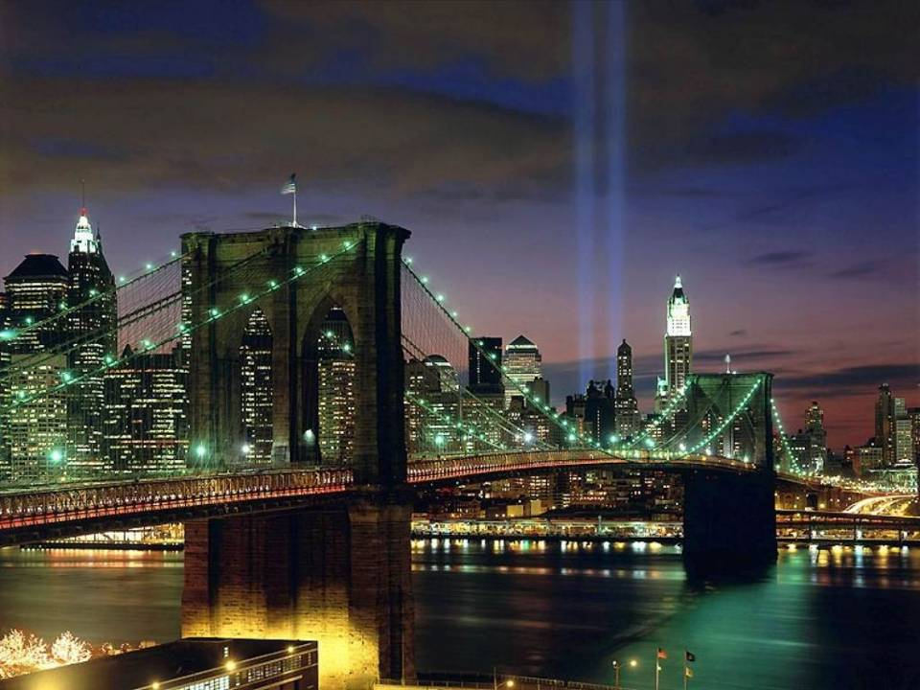
New York!

Slide 4
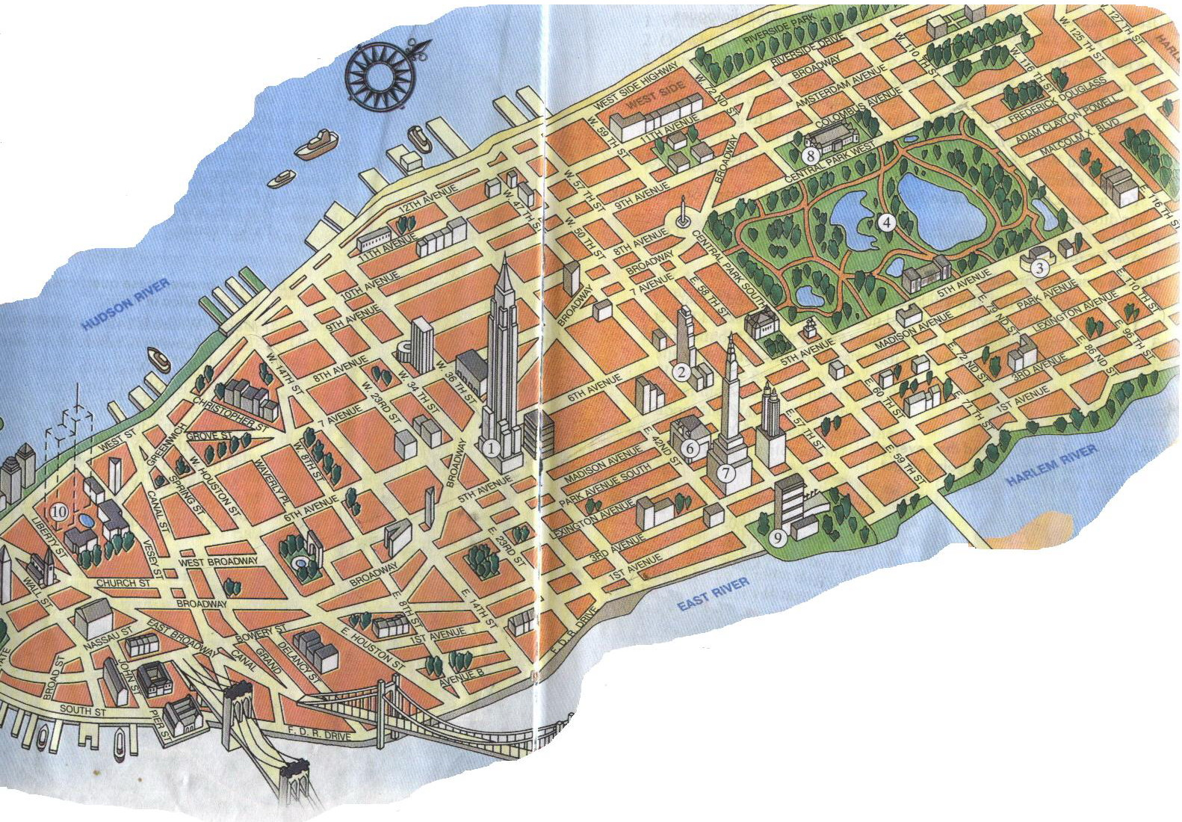
STREETS AND AVENUES
The Empier State Building
The Rockefeller Center
The Guggenheim Museum
Central Park
The Statue of Liberty
Central Station
The Chrysler Building
The American Museum of Natural History
The UN Headquarters
The World Trade Center

Slide 5
Writing and reading dates
In BrE they write "2 July / 2nd July / July 2". They say the "second of July" or "July the second".
In AmE they write "July 2nd / July 2". They say "July second".
Dates are sometimes written as numbers, for example, 3/10.
In BrE this means the third of Octoder.
In AmE it means the tenth of March.

Slide 6
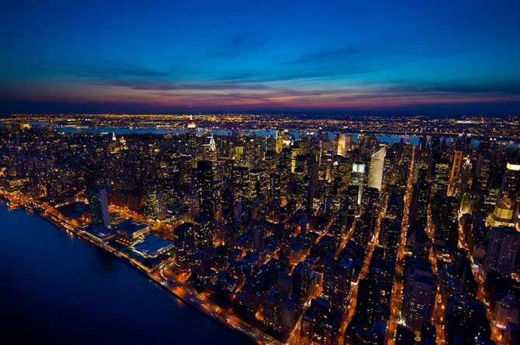
It`s difficult to get lost in New York. It has a very clever system of streets and avenues. Streets run east to west across the island and are often called cross-streets, while avenues run north to south down the island.

Slide 7
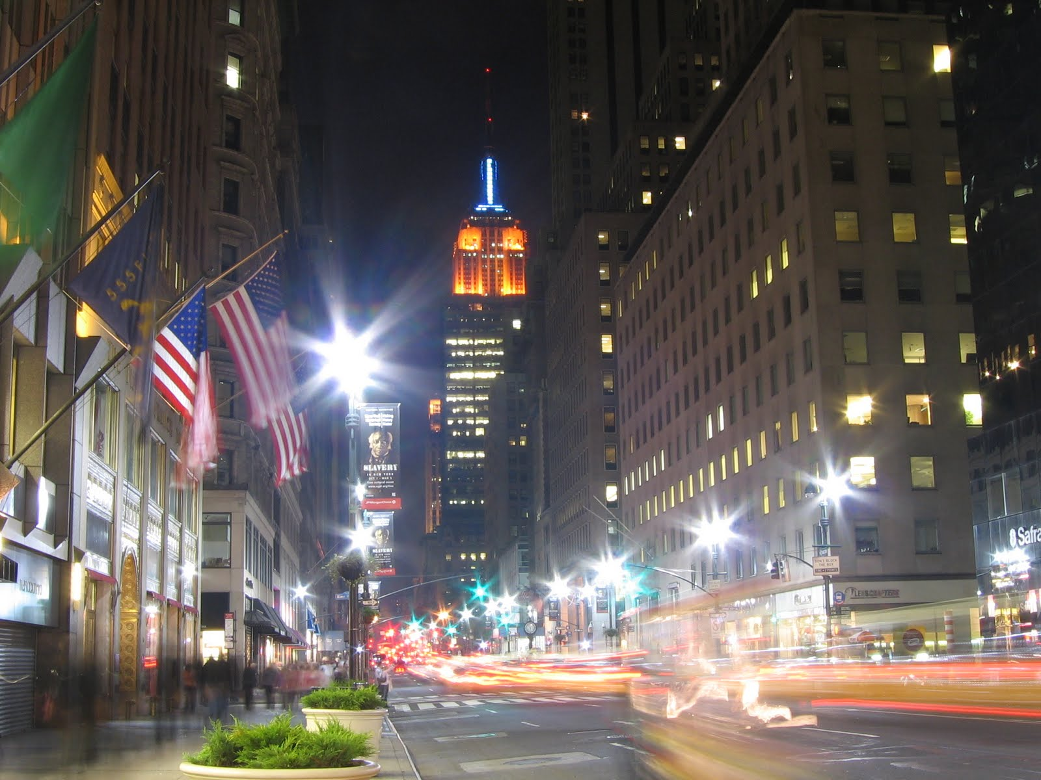
5th Avenue is one of the most expensive streets in the world

Slide 8
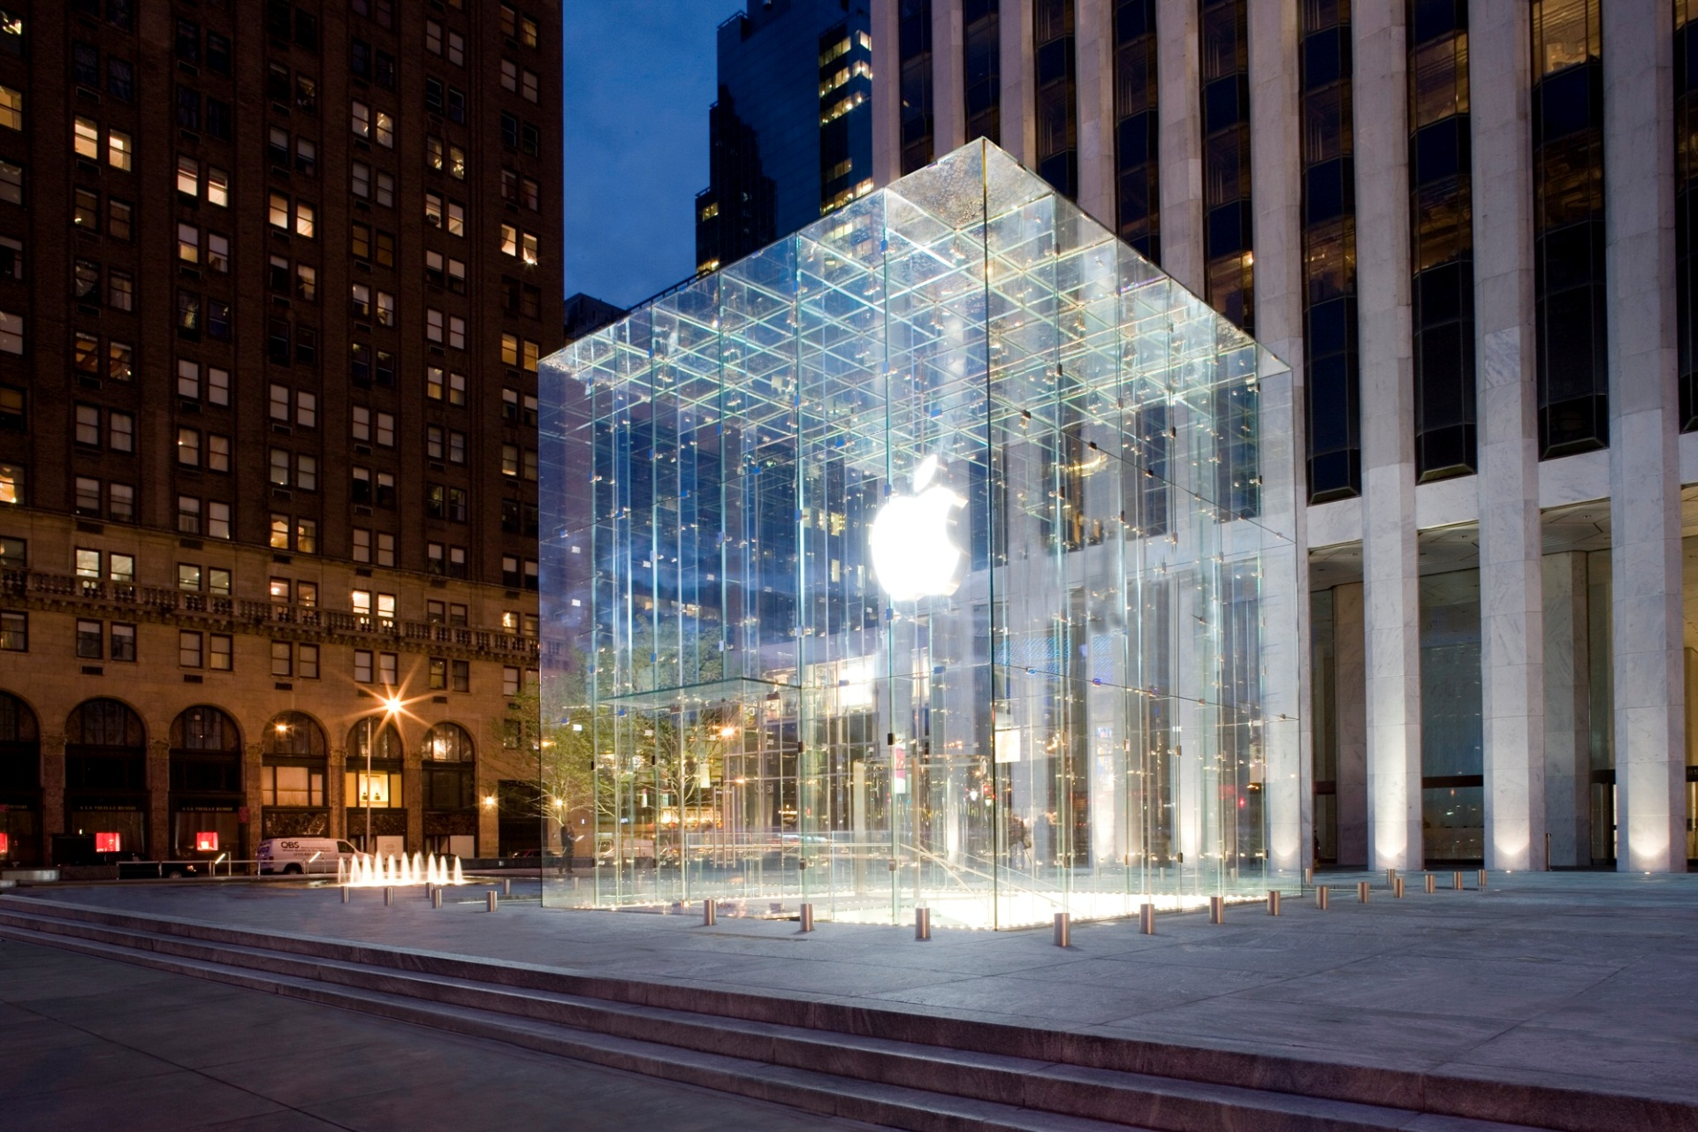
Apple Store, 5th Avenue

Slide 9
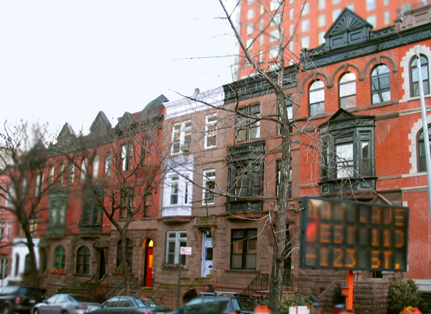
Manhattan Avenue
The story of Manhattan Avenue really starts a block away, at the corner of 105th
Street and Central Park West. This great building was the New York Cancer
Hospital, built in 1884. It's the predecessor of Sloan-Kettering Cancer Center.

Slide 10
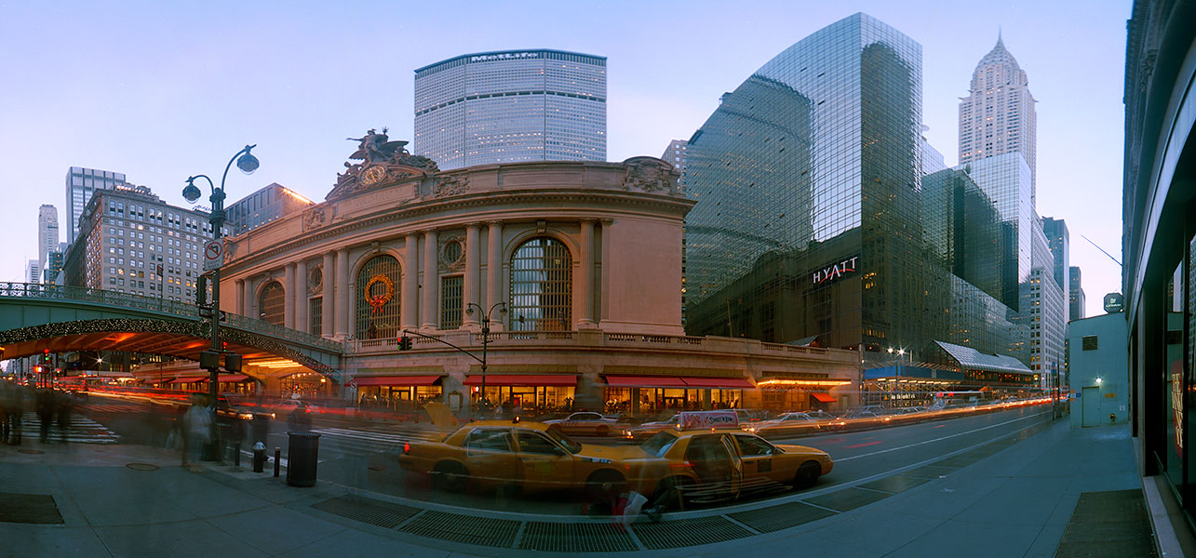
Grand Central Terminal is situated at the cross of 42 Street and Park Avenue.

Slide 11
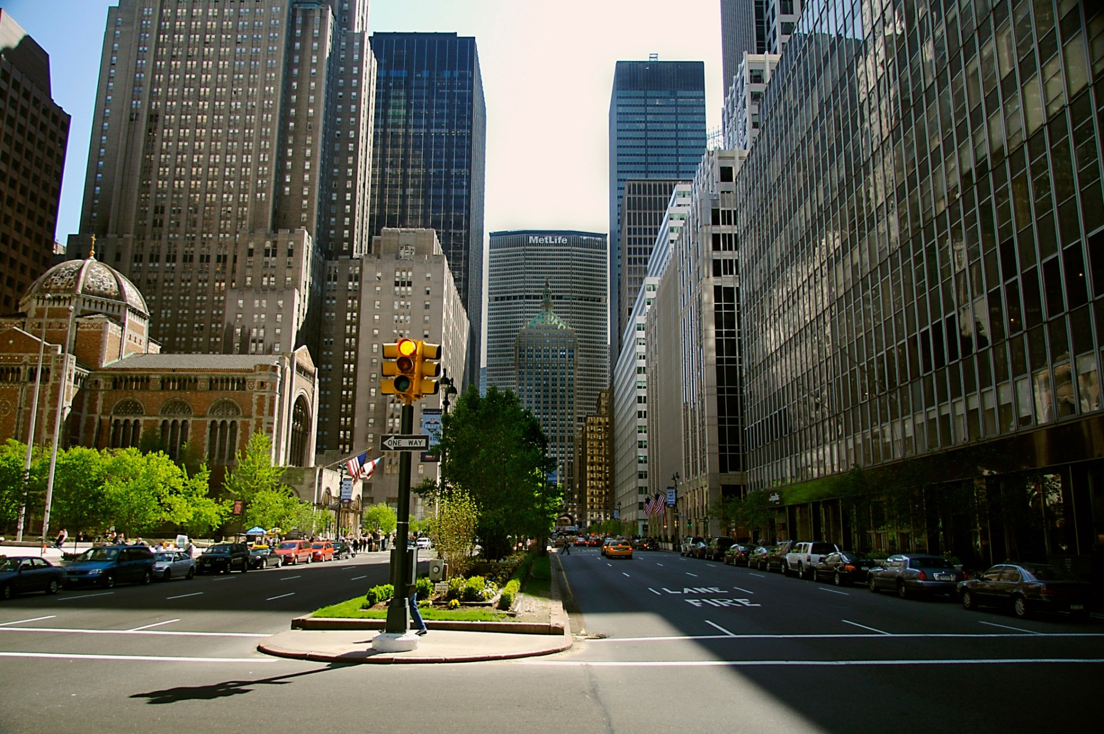
Park Avenue goes from Grand Central Terminal

Slide 12
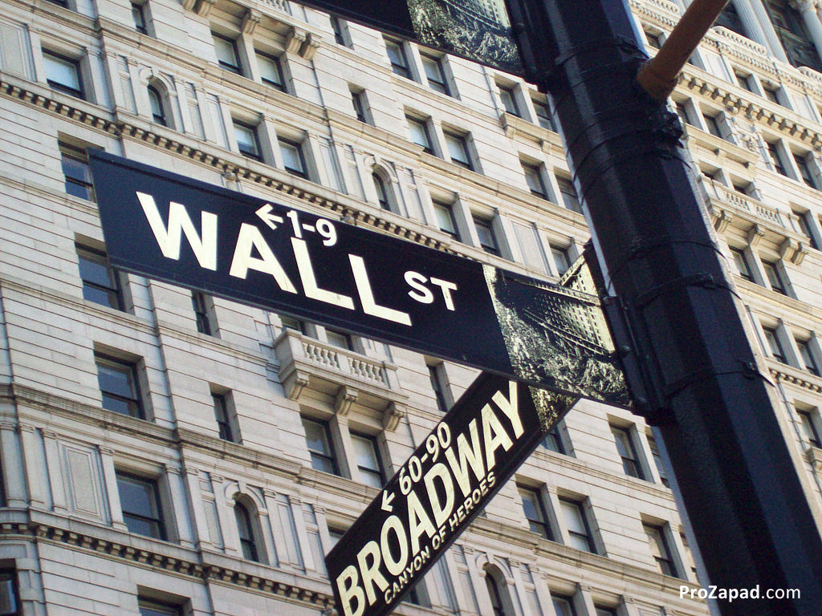
Wall Street is the financial center of the world

Slide 13
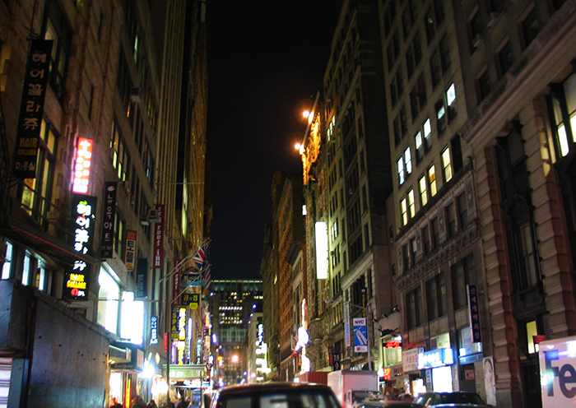
Korea Town
On 32nd Street, between Broadway and 5th Avenue, is "Korea Town", although it would more properly be called "Korea Block".

Slide 14
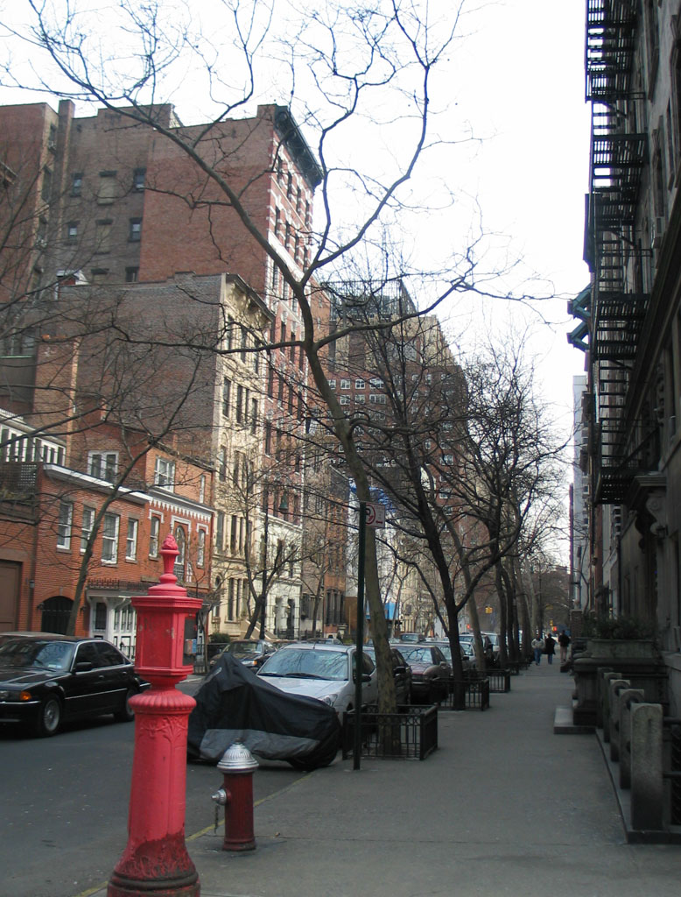
East 19th Street

Slide 15
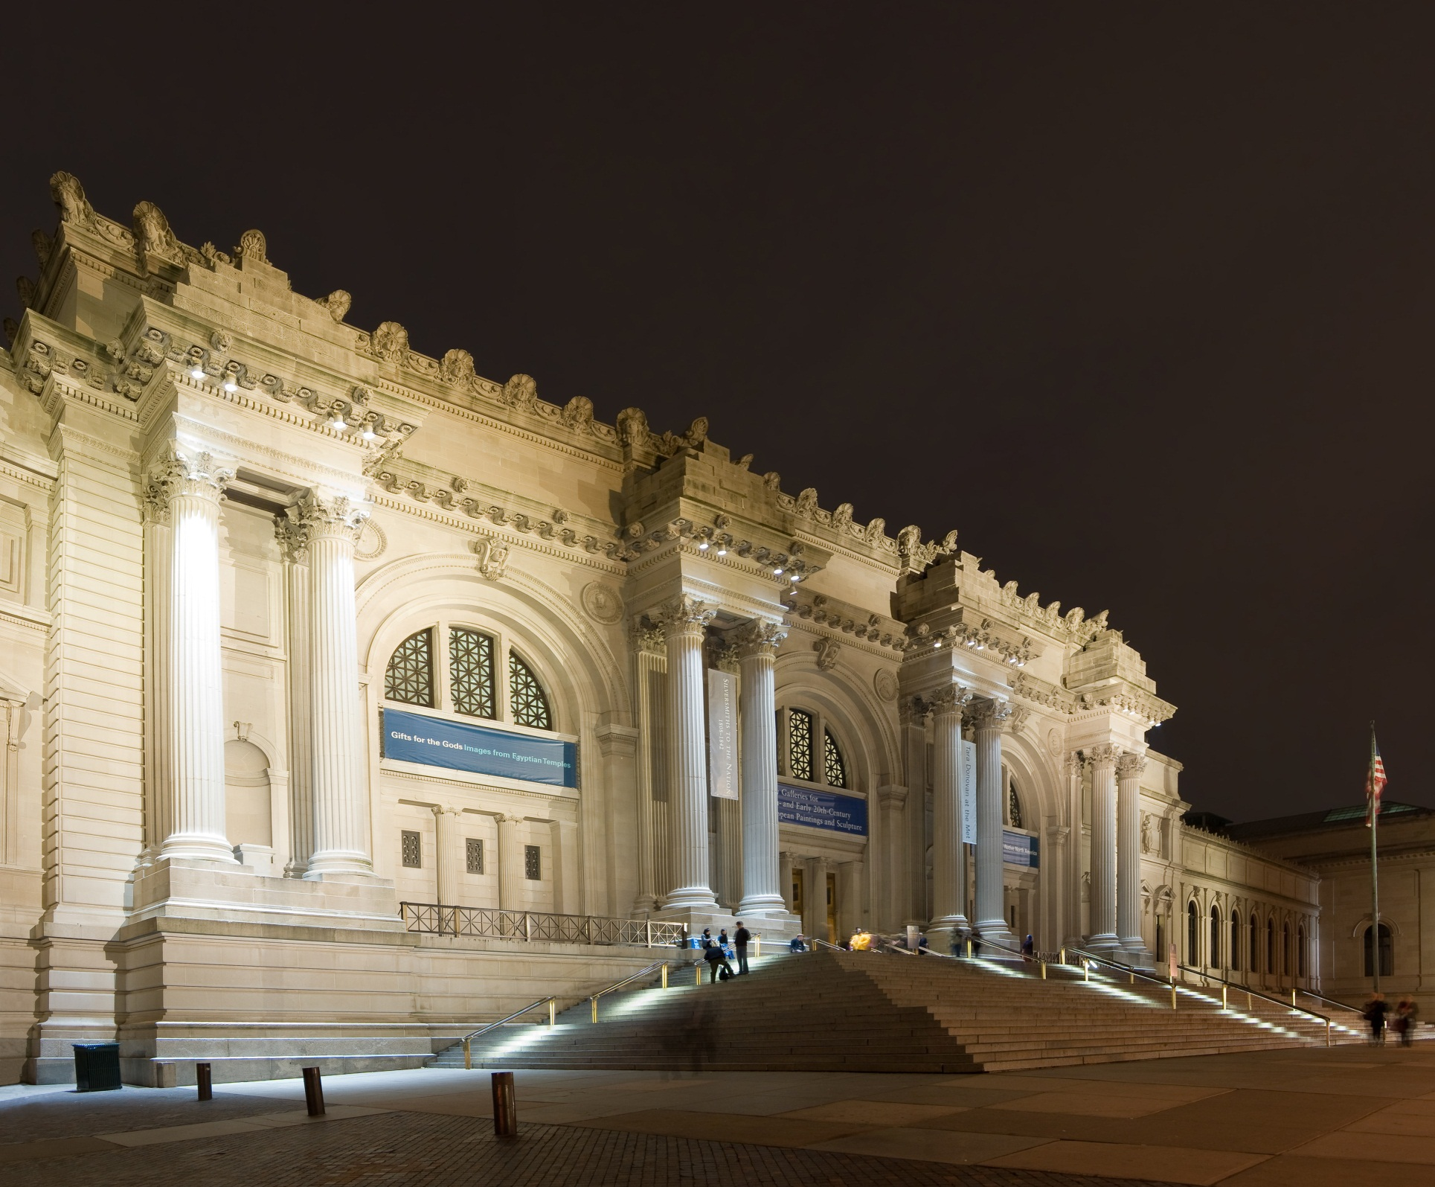
The Metropolitan Museum of Art (the Met)
It`s located in Central Park

Slide 16
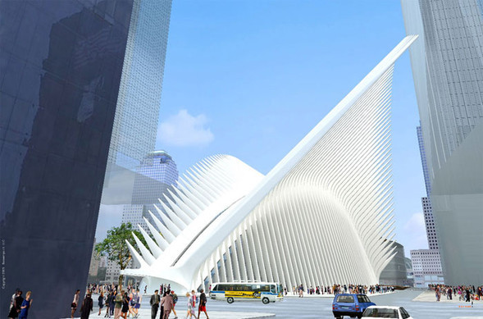
Subway (underground) station near Ground Zero Memorial

Slide 17
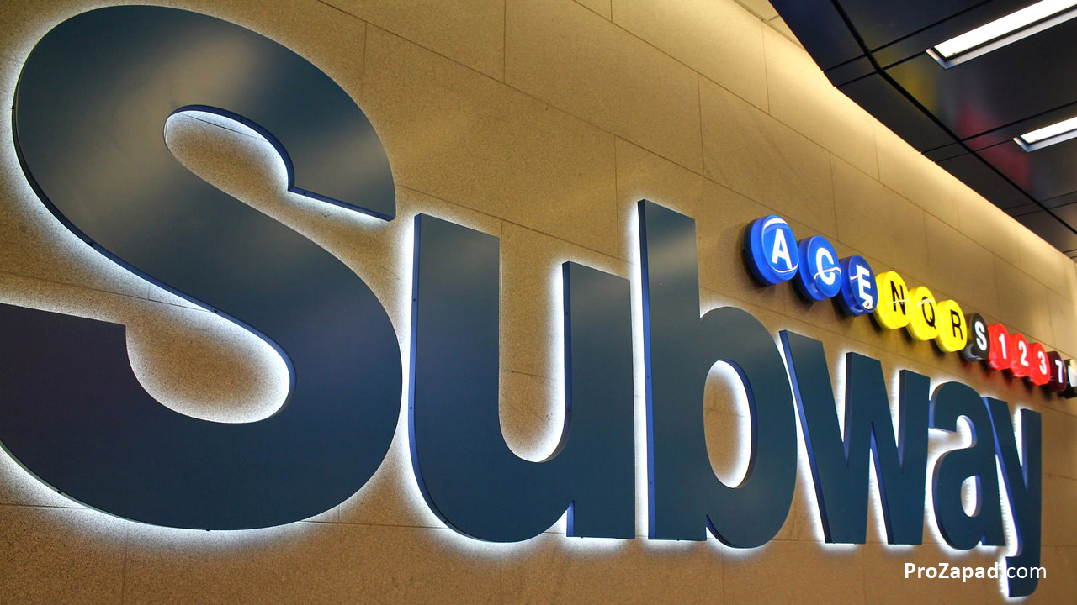
“Means of transport in New York”

Slide 18
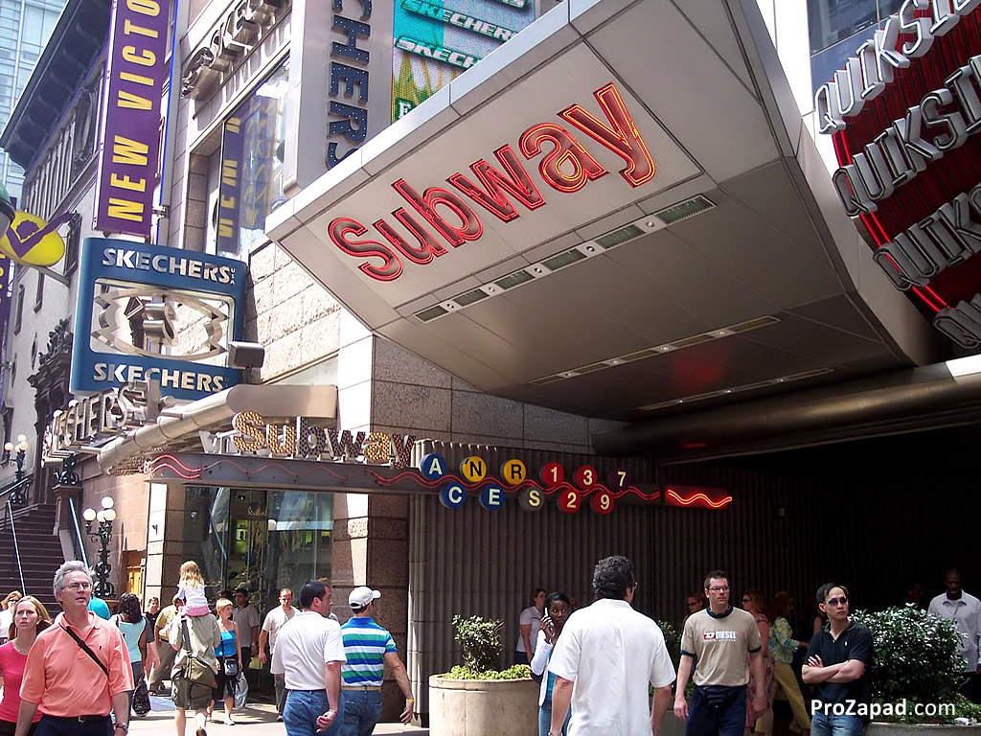
• Most of the subway stations have the same names as the streets.

Slide 19
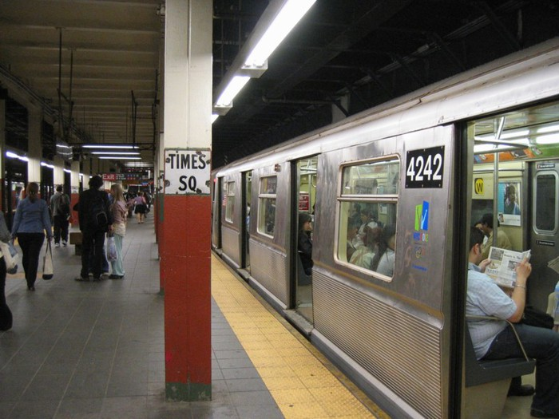

Slide 20
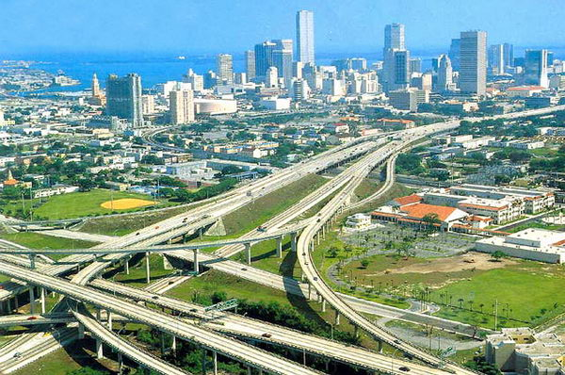

Slide 21
Say if the following information is true, false or not mentioned. If there is no information, try to guess. Explain your answers.
1. Mark and Rob are very excited about their first days in New Y
2. It's easy to find your way in New York.
3. Avenues run north to south.
4. Streets run parallel to the Hudson River.
5. All New York streets have numbers instead of names.
6. It doesn't take long to visit the Empire State Building.
7. Mark and Rob have been inside the Empire State Building.
8. Mark and Rob have been inside Rockefeller Center.
9. Mark and Rob have not been inside the Guggenheim Museum.
10. Broadway is famous because it's the longest avenue in New York
11. There are streets called Broadway in many American cities.
12. Central Park isn't very big.

Slide 22
Home task:
Imagine that you have visited New York.
Tell about the most interesting sights.

Slide 23
STREETS AND AVENUES
1.The Empire State Building
2.The Rockefeller Center
3.The Guggenheim Museum
4.Central Park
5.The Statue of Liberty
6.Central Station
7.The Chrysler
Building
8.The American
Museum of Natural History
9.The UN Headquarters
10.The World Trade Center

Slide 24


New York is on … River. Another name of New York
is … . It consists of 5 boroughs: … The heart of New
York is … It has a lot of … . One of them is … State
Building. It is the tallest … in New York. One of New
York’s most famous museum is … . One of the
famous symbols of America is … of Liberty. … is one
of the longest avenues in Manhattan.

Slide 25
Check yourself
New York is on the Hudson River.
Another name of New York is America’s Big Apple.
It consists of 5 boroughs: Manhatten, Brooklyn, Queens,
Staten Island and the Bronx. The heart of New York is
Manhattan. It has a lot of sights. One of them is the
Empire State Building. It is the tallest skyscraper in
New York. One of New York’s most famous museum
is the Solomon R. Guggenheim Museum. One of the
famous symbols of America is the Statue of Liberty.
Broadway is one of the longest avenues in Manhattan.

Slide 26
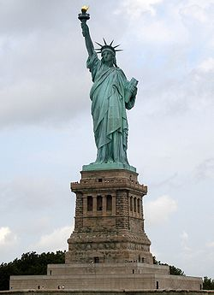
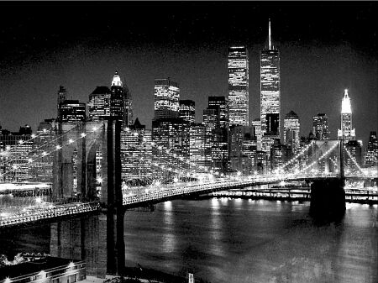
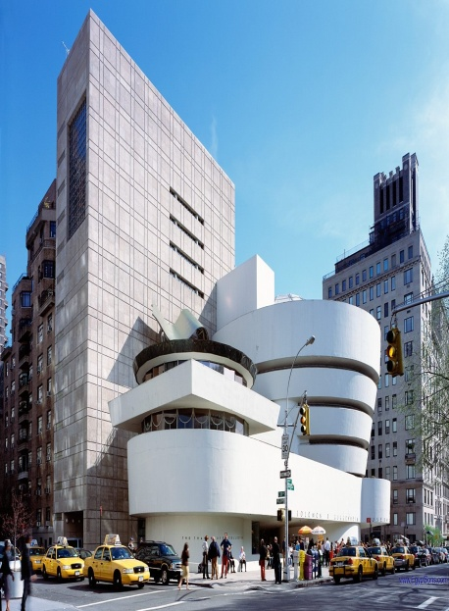
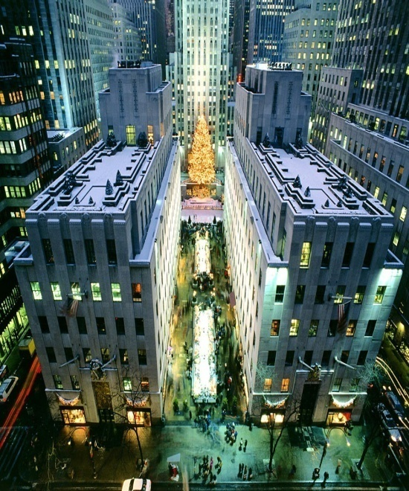
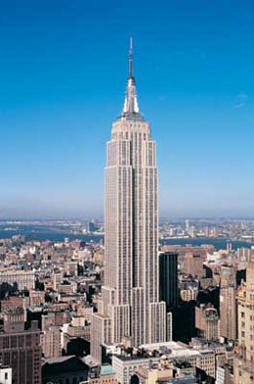
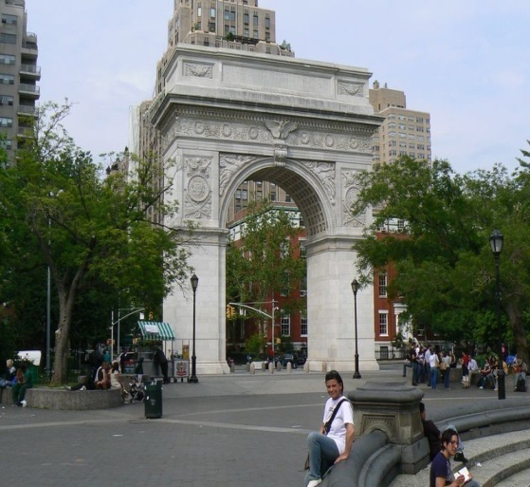
Name the sights

Slide 27



The Empire State Building
The Guggenheim Museum
                Central park
The Statue of Liberty
The Rockefeller Center
The Brooklyn Bridge

Slide 28
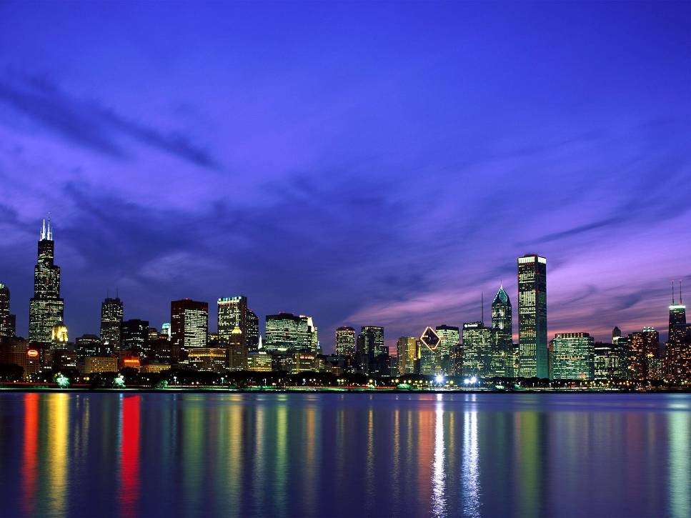
Match the beginning of each sentence with its end.
1.New York is 2.The nickname of the city is 3.Rockefeller Center is 4. The Empire State Building is 5.The Guggenheim Museum 6. NY is a multinational city and 7.The Statue of Liberty | a) was designed by a famous architect, Frank Lloyd Wright. b) welcomed millions of immigrants who had come to America by sea c) one the largest city in the USA . d) famous for its Christmas Trees. e) "a big apple". f) the inhabitants of the city speak 75 different languages. h) one of the world's best loved skyscrapers.

Slide 29
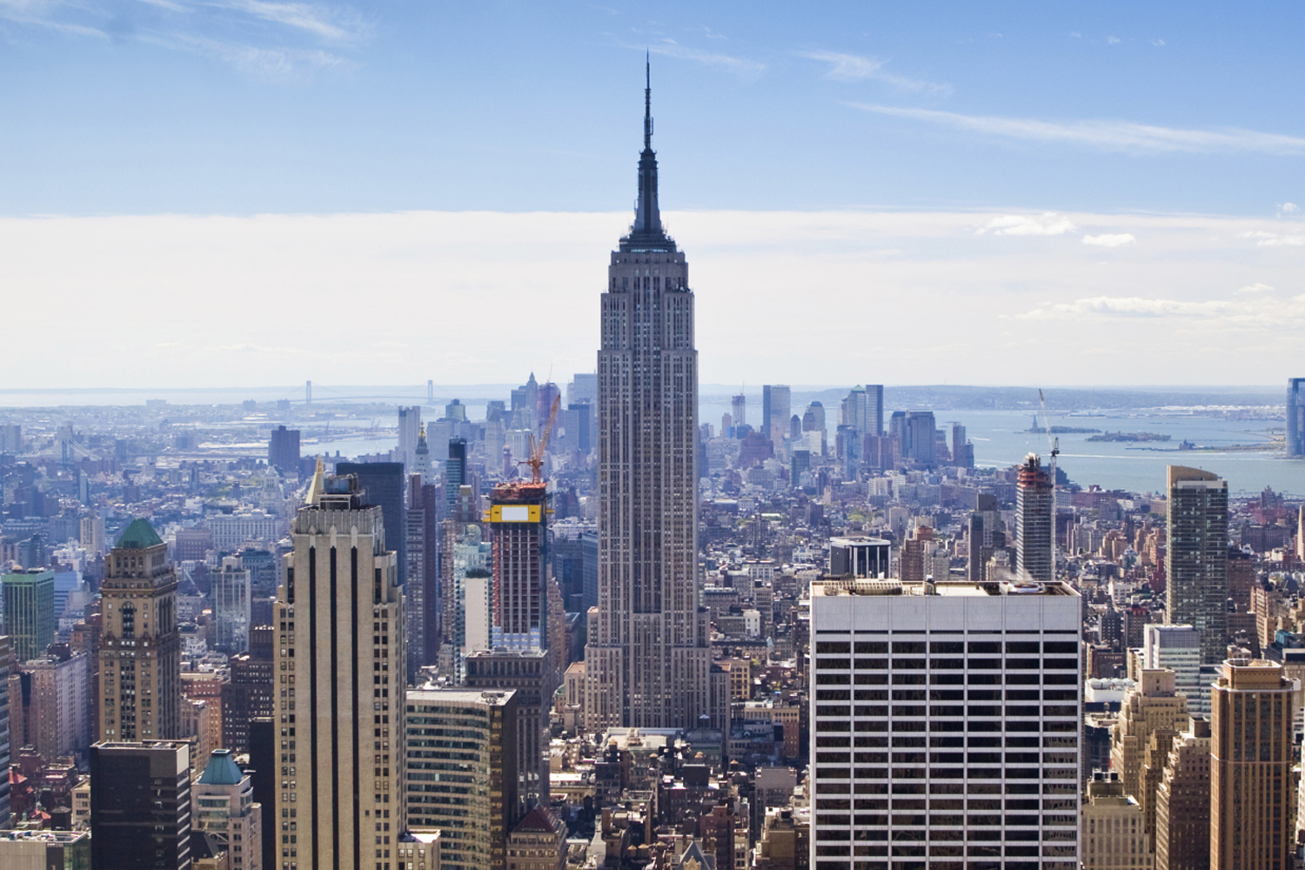
New York is one the largest city in the USA .
The nickname of the city is "a big apple".
Rockefeller Center is famous for its Christmas Trees.
The Empire State Building is one of the world's best loved skyscrapers.
The Guggenheim Museum was designed by a famous architect, Frank Lloyd Wright.
NY is a multinational city and the inhabitants of the city speak 75 different languages.
The Statue of Liberty welcomed millions of immigrants who had come to America by sea

Slide 30
Let’s read asking the way expressions.
Could you tell me where…is? It’s between the… and the…
Excuse me, how do I get to…? It’s on the corner…
Turn left (right)… Go up (down) the Street…
On the left (right) side… Go straight on…
It’s opposite the… Go past…
Keep going until you see…

Slide 31
C.P.
M.
H.

Slide 32
Make up dialogues.
Use the map of New York.
1. You are in Times Square and need to get to Penn Station. Ask for directions
2. You are on 59th Street and First Avenue. You need to get to the Guggenheim Museum. Ask for directions.
3. You are in Whitehall Street and need to get to the World Trade Center. Ask for directions.
4. You are at Lincoln Center and need to get to Grand Central Station. Ask for directions.
5. You are at the Empire State Building and want to get to Central Park. Ask for directions.

Slide 33
Home task:
Ex. A, B. p. 11.(W.B.)

Slide 34
Источники информации
К.И. Кауфман, М.Ю. Кауфман Английский язык: Счастливый английский.ру/ Happy English.ru: Учебник англ. яз. для 9 кл. общеобраз. учрежд. - Обнинск: Титул, 2008
2. Клементьева Т.Б., Шэннон Д.А. Счастливый английский. Кн. 2 для 7-9 кл.
общеобразов. шк. – 2-е изд., испр. – Обнинск: Титул, 2001
3. Голицынский Ю.Б. Соединенные Штаты Америки: Пособие по страноведению. –
СПб.: КАРО, 2006 – 448 с., ил.
4. Тобольская С.И. English-speaking countries. Страноведческий справочник: Учебное
пособие. – Саратов: Лицей, 2004. – 176 с.
http://terekhofff.at.ua/photo/nju_jork_foto
http://eamerica.ru/foto/new-york-2.php
http://all-new-york.ru/new-york/dostoprimechtelnosti/
http://lifeglobe.net/entry/1843
http://mirsovetov.ru/a/travels/travel-excursion/new-york-1.html
http://kartinki-na-rabochiy-st...
http://images.yandex.ru
http://prousa.ru/new_york_city
http://states-of-america.ru
http://content.mail.ru/arch/14...
http://www.biffen.ru

Slide 35
http://en.wikipedia....n_New_York_City
http://www.newyorkcitywalk.com/
http://www.ny.com/locator/
http://en.wikipedia....(New_York_City)
http://en.wikipedia....ki/Hudson_River
http://en.wikipedia....wiki/East_River
http://en.wikipedia....ki/Harlem_River

